Slide 1
Advanced JavaScript

Slide 2
Function call()

Slide 3
const person = {
fullName: function () {
return this.firstName + " " + this.lastName;
},
};
const person1 = {
firstName: "John",
lastName: "Doe",
};
console.log(person.fullName.call(person1));
Q
A
John Doe
What shows in the console?

Slide 4
const person = {
fullName: function (city, country) {
return this.firstName + " " + this.lastName + "," + city + "," + country;
},
};
const person1 = {
firstName: "John",
lastName: "Doe",
};
console.log(person.fullName.call(person1, "Oslo", "Norway"));
Q
A
John Doe,Oslo,Norway
What shows in the console?

Slide 5
Function apply()

Slide 6
const person = {
fullName: function () {
return this.firstName + " " + this.lastName;
},
};
const person1 = {
firstName: "Mary",
lastName: "Doe",
};
console.log(person.fullName.apply(person1));
Q
A
Mary Doe
What shows in the console?

Slide 7
const person = {
fullName: function (city, country) {
return this.firstName + " " + this.lastName + "," + city + "," + country;
},
};
const person1 = {
firstName: "John",
lastName: "Doe",
};
console.log(person.fullName.apply(person1, ["Oslo", "Norway"]));
Q
A
John Doe,Oslo,Norway
What shows in the console?

Slide 8
Function bind()

Slide 9
const person = {
firstName: "John",
lastName: "Doe",
fullName: function () {
return this.firstName + " " + this.lastName;
},
};
const member = {
firstName: "Hege",
lastName: "Nilsen",
};
let fullName = person.fullName.bind(member);
console.log(fullName());
Q
A
Hege Nilsen
What shows in the console?

Slide 10
const person = {
firstName: "John",
lastName: "Doe",
display: function () {
console.log(this.firstName + " " + this.lastName);
},
};
person.display();
Q
A
John Doe
What shows in the console?

Slide 11
const person = {
firstName: "John",
lastName: "Doe",
display: function () {
console.log(this.firstName + " " + this.lastName);
},
};
setTimeout(person.display, 3000);
Q
A
undefined undefined
What shows in the console?

Slide 12
const person = {
firstName: "John",
lastName: "Doe",
display: function () {
console.log(this.firstName + " " + this.lastName);
},
};
let display = person.display.bind(person);
setTimeout(display, 3000);
Q
A
John Doe
What shows in the console?

Slide 13
Object Prototypes

Slide 14
function Person(first, last, age, eye) {
this.firstName = first;
this.lastName = last;
this.age = age;
this.eyeColor = eye;
}
Person.prototype.nationality = "English";
const myFather = new Person("John", "Doe", 50, "blue");
console.log(myFather.nationality);
Q
A
English
What shows in the console?

Slide 15
function Person(first, last, age, eye) {
this.firstName = first;
this.lastName = last;
this.age = age;
this.eyeColor = eye;
}
Person.prototype.name = function () {
return this.firstName + " " + this.lastName;
};
const myFather = new Person("John", "Doe", 50, "blue");
console.log(myFather.name());
Q
A
John Doe
What shows in the console?

Slide 16
JavaScript CallBack Function

Slide 17
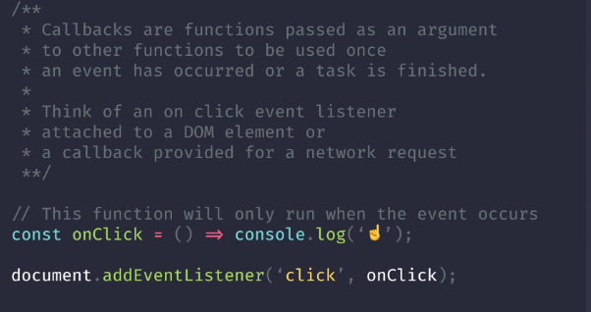

Slide 18
JavaScript IIFEs

Slide 19
